Slide 1
GSA Hackathon Focus Group

Slide 2
Overview
Approach
Mockups
Next Steps

Slide 3
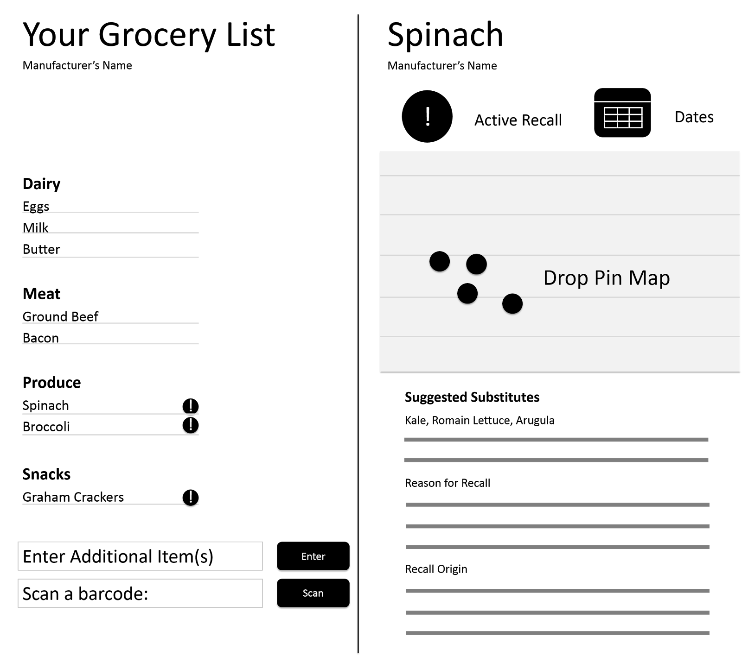
Overview
GSA Hackathon
What: Request for Quotation to establish multiple award Blanket Purchase Agreements for General Services Administration’s 18F, a fee-drive organization that designs, builds, and operates user-centric digital services and provides consulting services, due Friday 6/26
Challenge: design and develop a working prototype using datasets from the FDA
Our Solution
Grocery List Checker which allows you to share your grocery list and see which items may be under a recall
Lists can be entered manually or uploaded from an external source. Alternatively, individual items can be scanned using a mobile phone’s camera.
Grocery List Checker Initial Design

Slide 4
Approach
Our Methodology
Guiding principle: participatory, interactive, and collaborative process driven by users
Takes a user-centered approach throughout the design and development lifecycle to ensure the solution meets user needs, desires, and expectations by leveraging user-centered design techniques, including:
User Interviews to brainstorm user problems and potential solutions
Questionnaire to identify which solution users need and want
Personas to identify and define overarching user groups the solution will serve
Focus Group to define features users need and expect in the initial solution and to determine which features users would like in future iterations
User Acceptance Testing to ensure the solution meets user needs and to capture additional feedback

Slide 5
Mockups
About
How to navigate
Benefits
Information displayed
Grocery List Checker – Initial Page
Questions
What do you like/dislike?
What information would you like that is not currently displayed in the mockup?
Do you have any concerns?

Slide 6

Next Steps
Timeline
6/17
RFQ Released
6/18 Kickoff Meeting and Co-Design to Brainstorm Solution Ideas
6/19 Questionnaire to Identify Solution
6/24 Focus Group to Define Features
6/25 User Acceptance Testing
6/26 Prototype Delivery
6/21 Personas to Identify User Groups
User Acceptance Testing

